Slide 1
Introduction to OSS - Azure
Abdul Rasheed Feroz Khan

Slide 2

About the Instructor
Microsoft Most Valuable Professional – Azure
C# Corner Most Valuable Professional
Microsoft Certified Trainer
7 Years of experience as Cloud Consultant
Azure – AWS – GCP – IoT – Machine Learning – Cognitive Services – Bot – Xamarin – Big Data
Consultant for Accenture, Adobe, Boeing, Deloitte., Infosys, Johnson Controls, Microsoft, Wipro, etc.,

Slide 3
Azure Datacenter
Opened first datacenter in 1989
Investment of more than $15 billion on infrastructure
Geo-replication over 500 miles apart
24x7 monitoring by US screened persons

Slide 4
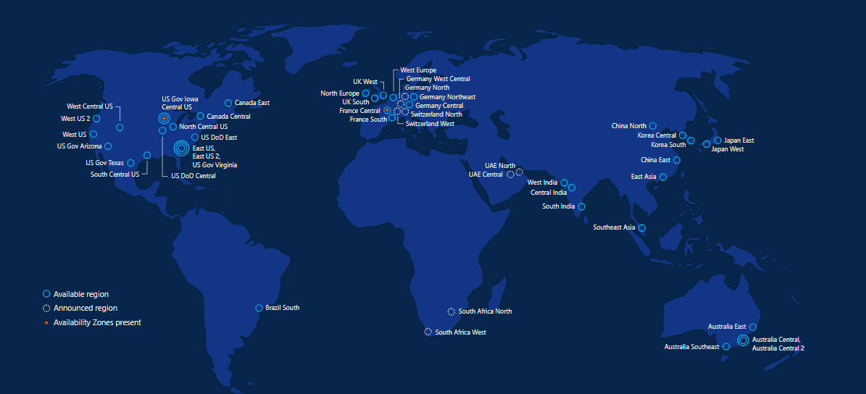
Azure regions – 50 Regions 140 Countries

Slide 5

Microsoft & Open Source

Slide 6

Inner Sourcing
In 2014, Microsoft CEO Satya Nadella directed all Microsoft engineers to "open source internally" - anyone at the company can see anyone else's code and use it as needed.
This vision is now a day-to-day reality for Microsoft engineers.
Notes:
Azure and Open Source – feedback from various UMICH departments is view that Azure is for “MSFT stack” and AWS is best for Open Source so need to emphasize our position on Open Source

Slide 7


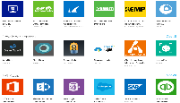






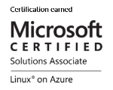
Microsoft + Open Source: Empowering Customers
Our Products
Our Offerings
Azure Marketplace
60% of all images in Azure Marketplace are based on Linux/OSS
SQL Server on Linux
Acquisition
Windows Subsystem for Linux
44% of VMs on Azure overall run Linux, and more than half of all new VMs run Linux
C:\Users\markhill> bash
44% / 1 in 3
HD Insight managed service on Linux
root@localhost: #
Run Linux on Windows natively
Our Partnerships
Our Employees
Ross Gardler President Apache SW Foundation
Brendan Burns
Co-Founder of Kubernetes
Partnership
Microsoft joins Eclipse Foundation
Partnership with the Linux Foundation for Linux on Azure certification
600 Million+
Lines of open source code
Partnership
Microsoft Open Source Hub
Jenkins project on Azure
Notes:
Notes coming soon – please check back on http://aka.ms/opensource for latest version

Slide 8












































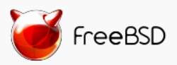

Azure is an open cloud
DevOps
Clients
Management
Applications
PaaS &
DevOps
App Frameworks
& Tools
Databases &
Middleware
Infrastructure
Notes:
P2

Slide 9
Why Linux on Azure
Our customers want it!
Roughly 1 out of 3 VMs run Linux & OSS
Enterprise grade cloud leadership
Only true hybrid cloud
Our goal is to be the most complete and open cloud

Slide 10







Linux images in the Azure Marketplace
Public Cloud
Azure Endorsed Linux Distributions
Published, maintained and supported by partners, curated & tested by Microsoft
Most endorsed distros maintain repos in each Azure region for fast updating
Standard Images
Customers can contact Linux vendor/partner for Linux support
Azure-related platform issues supported by Microsoft
Limited support for Linux issues -- from Microsoft
Premium Images
Microsoft engages the Linux vendor/partner on behalf of the customer for support
Includes updates, patches, and support through 24x7 web, email, chat and phone
Available for Red Hat Enterprise Linux and SUSE Linux Enterprise Server
Red Hat
Enterprise Linux
CoreOS
Ubuntu
OpenLogic
CentOS-based
SUSE Linux
Enterprise
Server
openSUSE
Oracle
Linux

Slide 11
Linux Distributions on Azure
CentOS
CoreOS
Debian
Oracle Linux
Red Hat Enterprise Linux
SUSE Linux Enterprise
openSUSE
Ubuntu

Slide 12
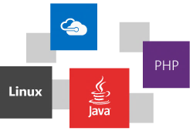

Slide 13
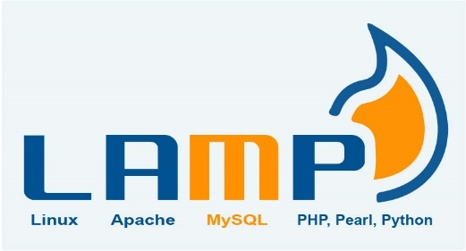

LAMP → Azure
Create an Ubuntu VM (the 'L' in the LAMP stack)
Open port 80 for web traffic
Install Apache, MySQL, and PHP
Verify installation and configuration

Slide 14
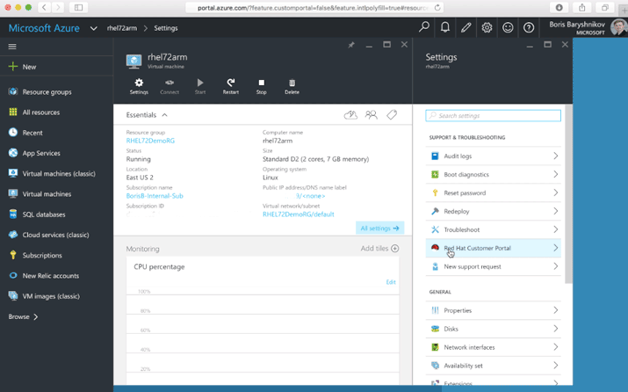
Accessing the Red Hat Customer Portal from Azure
With Azure “Pay As You Go” licensing, you can connect your subscription to Red Hat to access all Red Hat premium content and support.
Customers with existing Red Hat subscriptions may also seamlessly extend those to Azure using Red Hat Cloud Access
https://azure.microsoft.com/en-us/blog/red-hat-customer-portal-from-azure/
https://www.redhat.com/en/technologies/cloud-computing/cloud-access

Slide 15
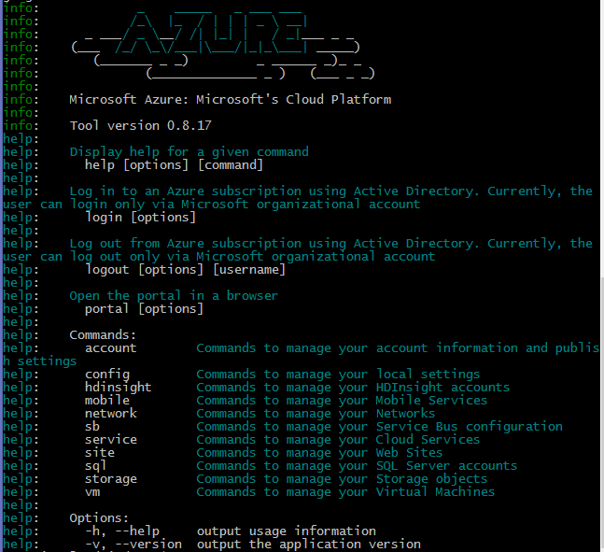
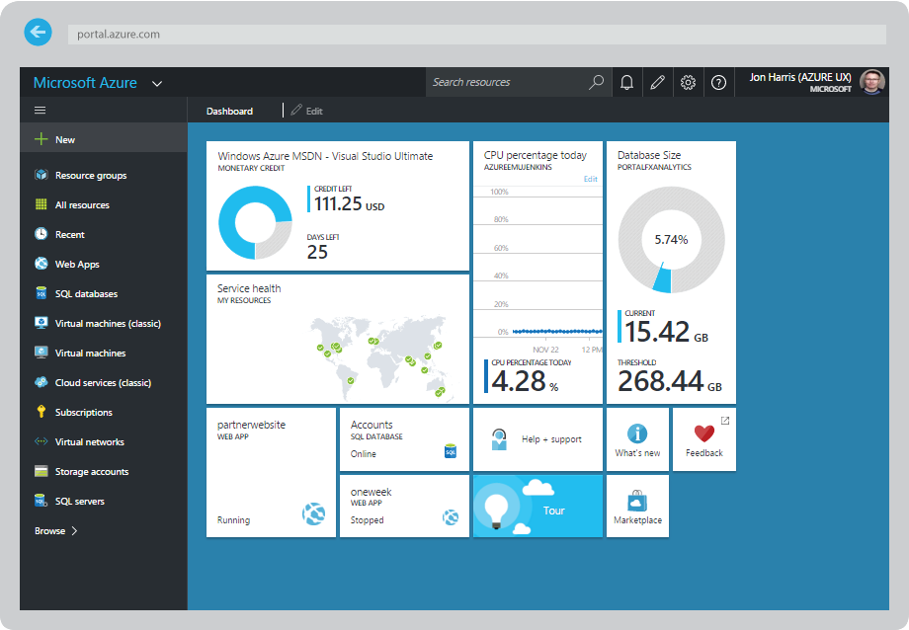
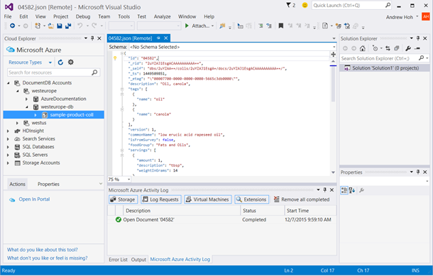
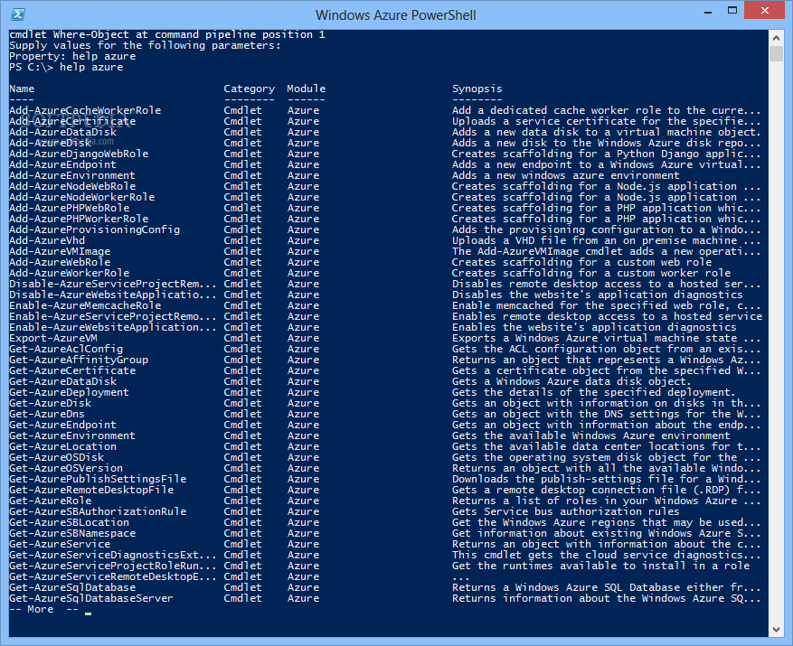
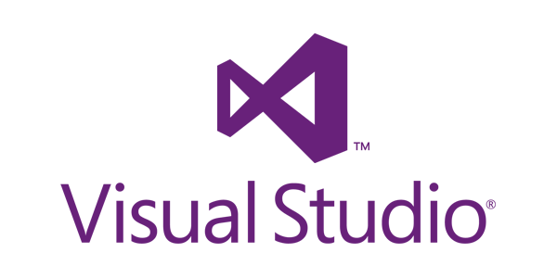
CLI, Portal, PowerShell, Visual Studio
Multiple ways to interact with Azure for any enterprise!
http://portal.azure.com
Linux Azure CLI Interface
http://aka.ms/azure-cli-2

Slide 16
Compute: IaaS, PaaS & Mobile Services

Slide 17
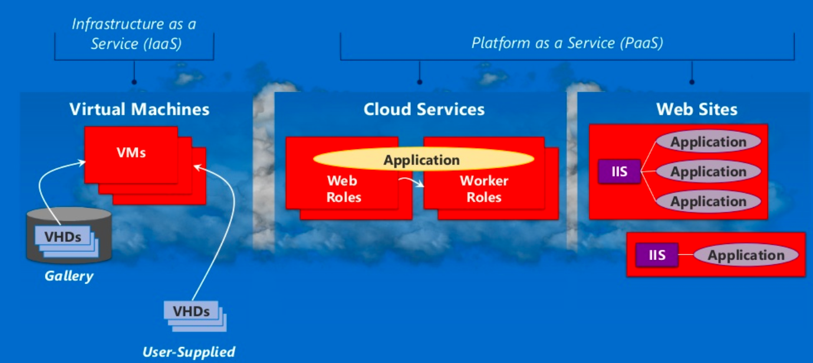
Azure Compute:

Slide 18
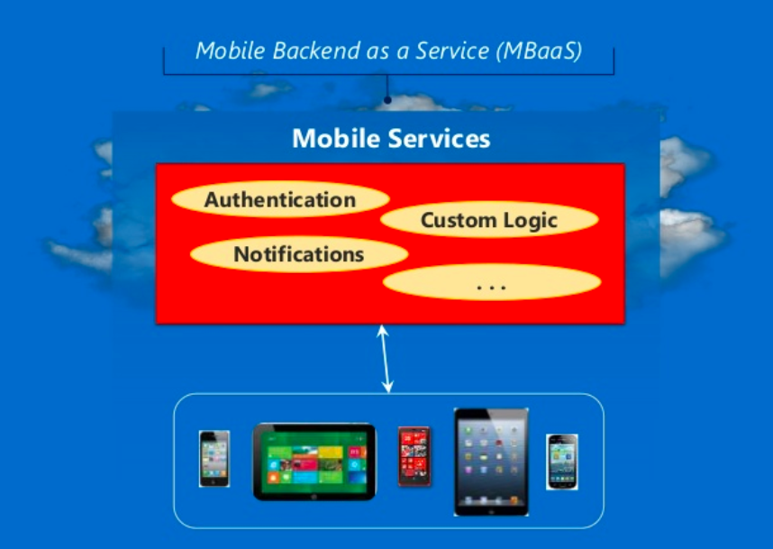
Azure Compute:

Slide 19
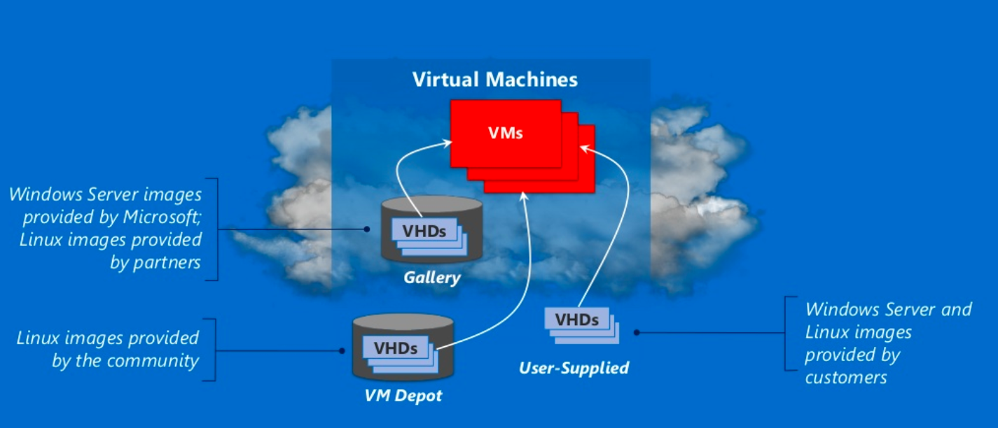
Azure Compute : IaaS

Slide 20
Linux Images:
Canonical UBUNTU
Oracle Linux
SUSE Linux Enterprise
OpenSUSE Linux
CENTOS by Open Logic
Notes:
Microsoft provides forum based support for all open source platforms today
Canonical Ubuntu – also available with pre-installed puppet enterprise from puppet labs.

Slide 21
Management with Puppet and Chef
Windows VM's
Linux VM's
Puppet Console
Chef Management Console

Slide 22
Linux images on Azure
Linux distributions
Images also includes other software
Notes:
The Linux images in the gallery just provides the OS
Linux distributions on other platforms like Debian are also available on azure.
Images also includes other softwares like wordpress

Slide 23
Pricing Comparison
Windows Server
Linux Server
Small A1 (1 Core, 1.75 GB) | $0.09 per hour
Medium A2 (2 Cores, 3.5 GB) | $0.18 per hour
Large A3 (4 Cores, 7 GB) | $0.36 per hour
Extra Large A4 (8 Cores, 14 GB) | $0.72 per hour
Memory Intensive A5 (2 Cores, 14 GB) | $0.33 per hour
Memory Intensive A6 (4 Cores, 28 GB) | $0.66 per hour
Memory Intensive A7 (8 Cores, 56 GB) | $1.32 per hour
Small A1 (1 Core, 1.75 GB) | $0.06 per hour
Medium A2 (2 Cores, 3.5 GB) | $0.12 per hour
Large A3 (4 Cores, 7 GB) | $0.24 per hour
Extra Large A4 (8 Cores, 14 GB) | $0.48 per hour
Memory Intensive A5 (2 Cores, 14 GB) | $0.25 per hour
Memory Intensive A6 (4 Cores, 28 GB) | $0.50 per hour
Memory Intensive A7 (8 Cores, 56 GB) | $1.00 per hour
Notes:
Standard pay as you go pricing
Linux is as much as 1/3 cheaper than windows server

Slide 24
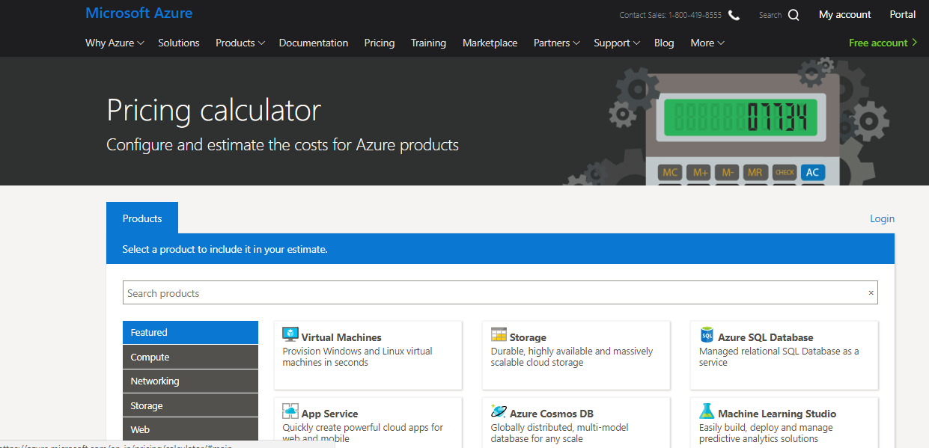
Demo

Slide 25
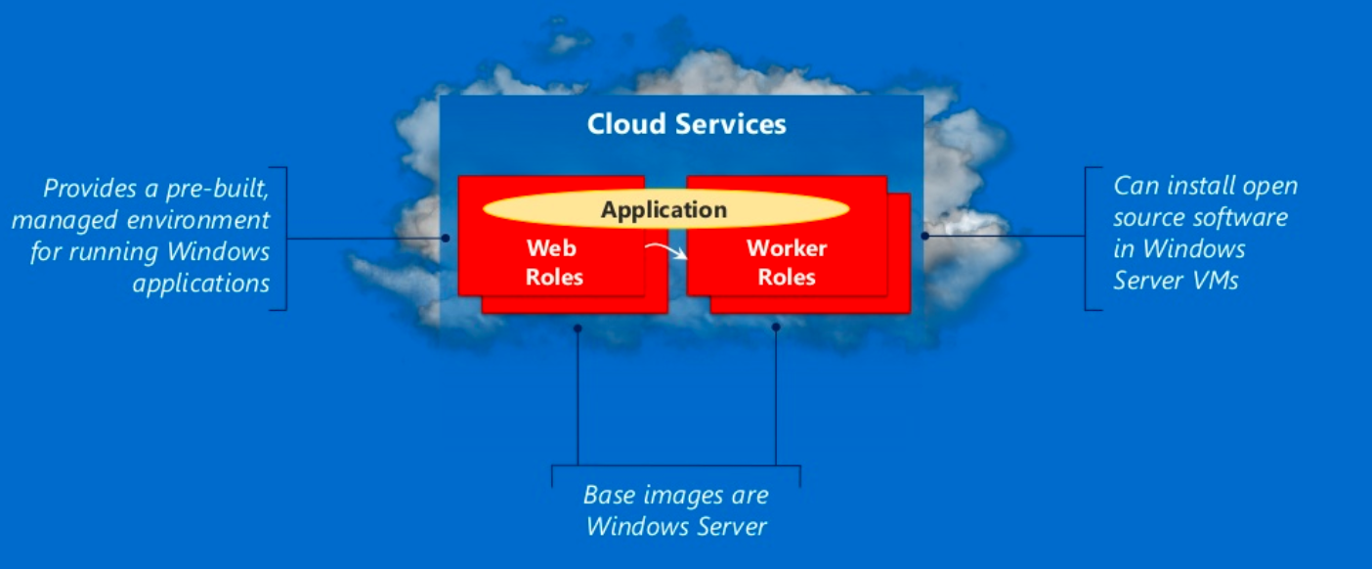
Azure Compute : PaaS

Slide 26
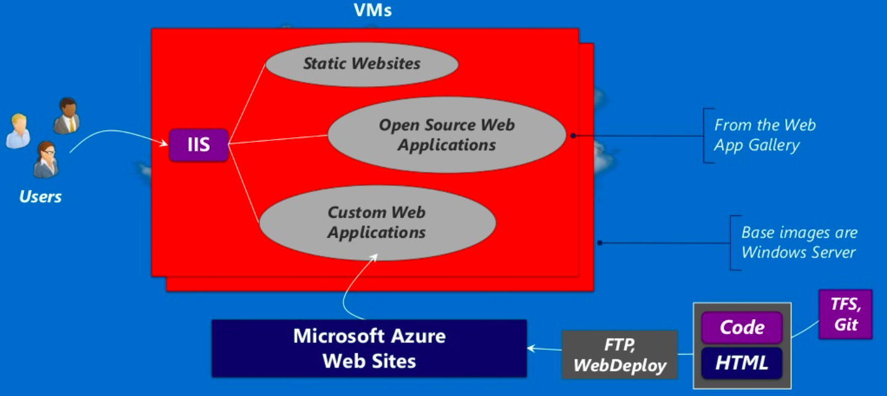
Azure Compute – PaaS - WebApps

Slide 27


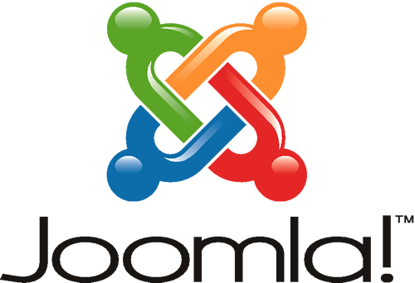
Azure Web Sites:
Applications | What it provides | Technology Foundation
Wordpress | Content Management System and Blogging | PHP/MySQL
Joomla | Content Management System | PHP/MySQL (and others)
Media Wiki | Wiki package | PHP/MySQL (and others)
Apache Tomcat | Web Server (or) Servlet Container | Java
Express | Web Framework | Javascript / Node.js

Slide 28


Supported Open Source Web Developments
Node.js
.
.
Notes:
PHP – Scripting language and environment for web development
Node.js - environment for web development with javascript
Python – general purpose dynamic programming language.
Note - .net and java applications are also supported.

Slide 29
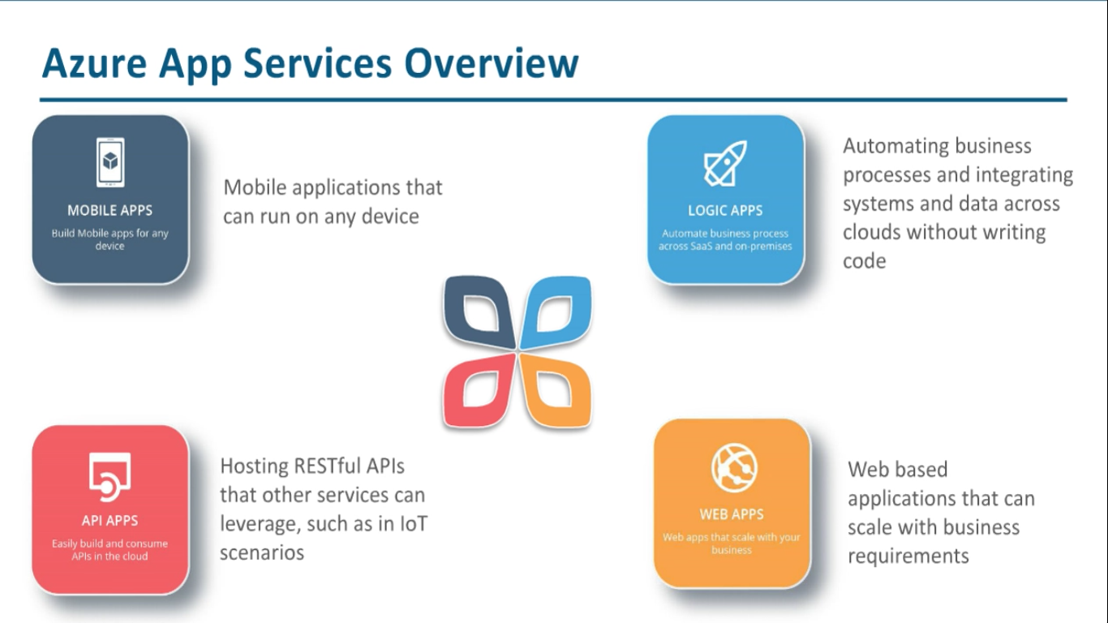

Slide 30
Data
SQL
NoSQL
Big Data Analytics

Slide 31
Azure with Open Source:
 | Operational Data | Analytical Data
NoSQL Technologies | Tables, Redis Cache Cassandra, HBase, etc., MongoDB Neo4J, etc., | Big Data Analytics – HDInsight, Hadoop
SQL Technologies | SQL Database, SQL Server, Oracle, MySQL, etc., | Relational Reporting & Relational Analytics
Notes:
Provided by Microsoft Azure – Runs in MS Azure VM's – Runs in MS Azure Virtual Machines and its open source

Slide 32
Operational NoSQL Databases
Example Technologies | What it provides?? | Example Use Cases
Redis – Azure Tables | Fast access to large amounts of simply structured data | Online shopping cart
Cassandra, HBase | Fast access to large amounts of more structured data | A table storing web pages
MongoDB | Scalable store for JSON documents | Persistent store for Node.js application
Notes:
Provided by Microsoft Azure – Runs in MS Azure VM's – Runs in MS Azure Virtual Machines and its open source

Slide 33
Linux 1. Create and Manage Linux VMs with the Azure CLI 2.0 in Azure Cloud Shell
You learn how to:
Create and connect to a VM
Select and use VM images
View and use specific VM sizes
Resize a VM
View and understand VM state
[Optional] Manage Disks: https://docs.microsoft.com/en-us/azure/virtual-machines/linux/tutorial-manage-disks
Important Notes
Use your Initials1514 or other unique code for variables to prevent any duplicate public urls e.g. (lowercase):
dan1514vm for “myVM”
Stop and Deallocate or Delete resources when done with ALL labs (you can reuse these machines for the next few labs but do not forget to go back after done with labs)
https://docs.microsoft.com/en-us/azure/virtual-machines/linux/tutorial-manage-vm
Notes:
High level demonstration steps
From the classroom VM, start Internet Explorer and browse to https://github.com/Azure /azure-quickstart-templates/tree/master/101-vm-simple-windows.
On the Very simple deployment of a Windows VM page, click Deploy to Azure.
On the Custom deployment blade, specify the following:
Subscription: Your subscription
Resource group: Create new
New resource group name: 10979D03-DemoRG03
Location: Azure region closest to the classroom location
Admin Username: Student
Admin Password: Pa55w.rd1234
Dns Label Prefix: Unique string consisting of lower-case letters and digits
Windows OS Version: 2016-Datacenter
Click I agree to the terms and conditions stated above.
Select the Pin to dashboard check box.
Click Purchase.
Note the Deployment started message in the notification area at the top of the page.
Do not wait for the deployment to complete. Continue with the next topic.

